Slide 1
Statistics: A Tool For Social Research
Eleventh Edition
Joseph F. Healey

Slide 2
Basic Descriptive Statistics:
Tables, Percentages, Ratios and Rates, and Graphs
Chapter 2

Slide 3
Learning Objectives
Explain how descriptive statistics can make data understandable.
Construct and analyze frequency distributions for variables at each of the three levels of measurement.
Compute and interpret percentages, proportions, ratios, rates, and percentage change.
Analyze bar and pie charts, histograms, and line graphs.
Use SPSS to generate frequency distributions and analyze the output.

Slide 4
Chapter Outline
Frequency Distributions for Nominal-Level Variables
Enhancing Clarity: Percentages and Proportions
Frequency Distributions for Ordinal-Level Variables
Frequency Distributions for Interval-Ratio-Level Variables
Ratios, Rates, and Percentage Change
Using Graphs to Present Data
Interpreting Statistics: Changing Patterns of American Family Life

Slide 5
Percentages and Proportions (1 of 2)
Report relative size
Compare the number of cases in a specific category to the number of cases in all categories
Compare a part (specific category) to a whole (all categories)
  The part is the numerator (f )
  The whole is the denominator (N)

Slide 6
Percentages and Proportions (2 of 2)
What percentage of a group of people is female?
  The whole is the number of people in the group
  The part is the number of females
To identify the whole and the part, use the keywords of and is
  of identifies the whole (N)
  is identifies the part (f)

Slide 7
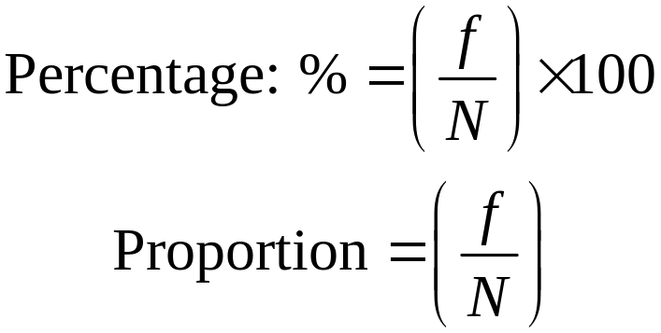
Percentages and Proportions: Formula
Where f = Frequency, or the number of cases in any category
N = the number of cases in all categories

Slide 8
Percentages and Proportions: Three Examples (1 of 3)
Self-Described Religious Affiliation of Adult Americans, 2018
Religious Group | Frequency | Percentages
Protestant | 124,148,263 | 48.9
Catholic | 53,822,969 | 21.2
Jewish | 4,315,993 | 1.7
Muslim | 1,777,173 | 0.7
Buddhist | 2,031,055 | 0.8
None | 59,154,489 | 23.3
Other | 8,631,985 | 3.4
 | N = 253,881,927 | 100.0%

Slide 9
Percentages and Proportions: Three Examples (2 of 3)
Declared Major Fields on Two College Campuses (fictitious data)
Major | College A | College B
Business | 103 | 3120
Natural sciences | 82 | 2799
Social sciences | 137 | 1884
Humanities | 93 | 2176
 | N = 415 | N = 9979

Slide 10
Percentages and Proportions: Three Examples (3 of 3)
Declared Major Fields on Two College Campuses (fictitious data)
Major | College A | College B
Business | 24.82 % | 31.27 %
Natural sciences | 19.76 % | 28.05 %
Social sciences | 33.01 % | 18.88 %
Humanities | 22.41 % | 21.81 %
 | 100.00 % | 100.00 %
 | (415) | (9979)

Slide 11
Percentages and Proportions: Calculation Examples
What % of social science majors are male?
  of (whole) = all social science majors
    97 + 132 = 229
  is (part) = male social science majors
    97
  (97/229) * 100 = (.4236) * 100 = 42.36%
  42.36% of social science majors are male

Slide 12
Percentages & Proportions: Guidelines
With small number of cases (less than 20), report actual frequencies
Always report number of observations along with proportions and percentages
Can calculate percentages and proportions for variables at all levels of measurement

Slide 13
Ratios
Compare the relative sizes of categories
Compare parts to parts
Ratio = f₁ / f₂
  f₁ is the number of cases in first category
  f₂ is the number of cases in second category

Slide 14
Ratios: Calculation Steps
Determine the values of f₁ (the number of cases in category 1) and f₂ (the number of cases in category 2)
Divide f₁ by f₂
Multiply by a power of 10 (optional)

Slide 15
Ratios: Calculation Examples
In a class of 23 females and 19 males, the ratio of males to females is:
  19/23 = 0.83
  For every female, there are 0.83 males
In the same class, the ratio of females to males is:
  23/19 = 1.21
  For every male, there are 1.21 females

Slide 16
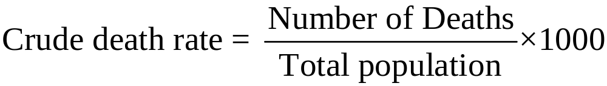
Rates (1 of 2)
Express the number of actual occurrences of an event (births, deaths, homicides) vs. the number of possible occurrences per some unit of time.
Example: Crude death rate

Slide 17
Rates (2 of 2)
Determine the number of occurrences (f)
Determine the possible number of occurrences (n)
Divide the actual occurrences (f) by the possible occurrences (n)
Multiply by a power of 10 (often 1,000 or 100,000)

Slide 18
Rates: Calculation Examples
Birth rate is the number of births divided by the population size times 1000 per year
If a town of 2300 had 17 births last year, the birth rate is:
  (17/2300) * 1000 = (.00739) * 1000 = 7.39
  The town had 7.39 births for every 1000 residents

Slide 19
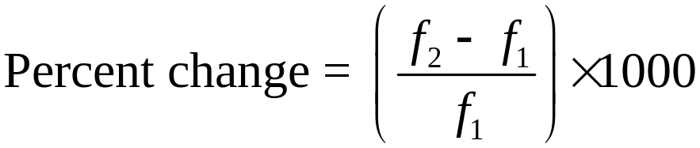
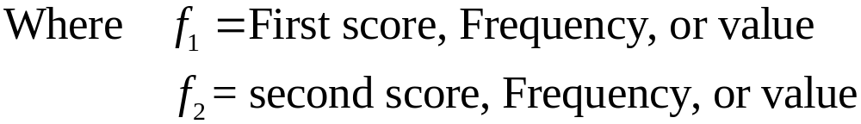
Percentage Change (1 of 2)
Measures the relative increase or decrease in a variable over time

Slide 20
Percentage Change (2 of 2)
f₁ is the first (or earlier) frequency
f₂ is the second (or later) frequency
Percentage change can also be calculated with percentages, rates, or other values
Percentage change can be positive (indicating increase from time 1 to time 2) or negative (indicating decrease from time 1 to time 2)

Slide 21
Percentage Change: Calculation Steps
Determine the values for f₁ (the value at time 1) and f₂ (the value at time 2)
Subtract f₁ from f₂ (f₂ - f₁)
Divide by f₁
Multiply by 100

Slide 22
Percentage Change: Calculation Example
In 1990, a state had a murder rate of 7.3.
By 2000, the rate had increased to 10.7.
What was the relative change?
  (10.7 – 7.3 / 7.3) * 100 = (3.4 / 7.3) * 100 = 46.58%
The rate increased by 46.58%.

Slide 23
Percentage Change: Example
Projected Population Growth for Six Nations, 2018–2050
Nation | Population, 2018 (f₁) | Population, 2050 (f₂) | Increase/Decrease (f₁−f₂) | Percentage change
China | 1,393,800,000 | 1,343,900,000 | −49,900,000 | −3.58
U.S | 328,000,000 | 389,600,000 | 61,600,000 | 18.78
Nigeria | 195,900,000 | 410,600,000 | 214,700,000 | 109.60
Mexico | 130,800,000 | 164,300,000 | 33,500,000 | 25.61
U.K. | 66,400,000 | 74,700,000 | 8,300,000 | 12.50
Canada | 37,200,000 | 49,900,000 | 12,700,000 | 34.14
Source: Population reference Bureau, 2019. 2018 World Population Data Sheet. Retrieved from https://
www.prb.org/2018-world-population-data-sheet-with-focus-on-changing-age-structures/

Slide 24
Frequency Distributions
Frequency distributions are tables that report the number of cases in each category of a variable
Frequency distributions summarize distribution of a variable by reporting the number of times each score of a variable occurred
General Rule for categories of frequency distribution:
  Exhaustive
  Mutually exclusive
    Each case counted in one and only one category

Slide 25
Frequency Distributions for Nominal Level Variables: Three Examples
Gender (fictitious data)
TABLE 2.3 Self-Described Religious Affiliation of Adult Americans, 2018
Gender | Frequency
Males | 53
Females | 60
 | N = 113
Religious Group | Frequency
Protestant | 124,148,263
Catholic | 53,822,969
Jewish | 4,315,993
Muslim | 1,777,173
Buddhist | 2,031,055
None | 59,154,489
Other | 8,631,985
 | N = 253,881,927
TABLE 2.2 Self-Described Religious Affiliation of Adult Americans, 2018
Religious Group | Frequency
Protestant | 124,148,263
Catholic | 53,822,969
Jewish | 4,315,993
None | 59,154,489
Other | 12,440,215
 | N = 253,881,929
Source: General Social Survey, 2018. Frequencies are approximations computed by multiplying the percentage in each category by the total adult population in 2018.
Source: General Social Survey, 2018. Frequencies are approximations computed by multiplying the percentage in each category by the total adult population in 2018.

Slide 26
Frequency Distributions for Ordinal Level Variables: Two Examples
Support for Birth Control on a University Campus (fictitious data)
Do you strongly agree, agree, disagree, or strongly disagree that the University Health Center should provide condoms and other “safe sex” items on demand and at no additional cost to students?
Response | Frequency | Percentage
Strongly Agree | 350 | 25.55%
Agree | 462 | 33.72%
Disagree | 348 | 25.40%
Strongly Disagree | 210 | 15.33%
 | 1370 | 100.00%
Support for Birth Control on a University Campus (fictitious data)
Do you strongly agree, agree, disagree, or strongly disagree that the University Health Center should be able to provide condoms and other “safe sex” items on demand and at no additional cost to students?
Response | Frequency | Percentage
Strongly Agree or Agree | 812 | 59.27%
Disagree or Strongly Disagree | 558 | 40.73%
 | 1370 | 100.00%

Slide 27
Frequency Distributions for Interval-Ratio Level Variables
Basic Considerations
  Complexity
  Large number of scores
  Requires collapsing or grouping of categories
  Decide the number of categories and the width of those categories
  Class intervals refer to the categories used in the frequency distribution

Slide 28
Frequency Distributions for Interval-Ratio Level Variables: Grouped and Ungrouped
Age of Students in a College Class (fictitious data)
Age of Students in a College Class (fictitious data)
Interval width = 2 years of age
Interval width = 1 year of age
Ages | Frequency | Percentage
18–19 | 11 | 55.0%
20–21 | 5 | 25.0%
22–23 | 2 | 10.0%
24–25 | 1 | 5.0%
26–27 | 1 | 5.0%
 | N = 20 | 100.0%
Ages | Frequency
18 | 5
19 | 6
20 | 3
21 | 2
22 | 1
23 | 1
24 | 1
25 | 0
26 | 1
 | N = 20

Slide 29
Class Intervals: Midpoints
Midpoints are the point exactly half way between the upper and lower limits of a class interval. To calculate: Add the upper limit to the lower limit and divide by 2.
Finding Midpoints
Class interval width = 3
Class Interval | Midpoint
0–2 | 1.0
3–5 | 4.0
6–8 | 7.0
9–11 | 10.0
Class interval width = 6
100–105 | 102.5
106–111 | 108.5
112–117 | 114.5
118–123 | 120.5

Slide 30
Class Intervals:
Stated Limits and Real Limits
Real Class Limits
Stated Limits | Real Limits
18–19 | 17.5–19.5
20–21 | 19.5–21.5
22–23 | 21.5–23.5
24–25 | 23.5–25.5
26–27 | 25.5–27.5
Class Intervals (stated limits) | Real Class Limits
3–5 | 2.5–5.5
6–8 | 5.5–8.5
9–11 | 8.5–11.5
Class Intervals (stated limits) | Real Class Limits
100–105 | 99.5–105.5
106–111 | 105.5–111.5
112–117 | 111.5–117.5
118–123 | 117.5–123.5

Slide 31
Cumulative Frequency and Cumulative Percentage
Cumulative frequencies and percentages refer to how many cases fall below a given score or class interval
Age of Students in a College Class
Age | Frequency | Cumulative Frequency | Percentage | Cumulative percentage
18–19 | 11 | 11 | 55.0% | 55.0%
20–21 | 5 | 16 | 25.0% | 80.0%
22–23 | 2 | 18 | 10.0% | 90.0%
24–25 | 1 | 19 | 5.0% | 95.0%
26–27 | 1 | 20 | 5.0% | 100.0%
 | N = 20 |  | 100.0%

Slide 32
Unequal Class Intervals (1 of 2)
Open-Ended Intervals
Age of Students in a College Class (N = 21)
Age | Frequency | Cumulative Frequency
18–19 | 11 | 11
20–21 | 5 | 16
22–23 | 2 | 18
24–25 | 1 | 19
26–27 | 1 | 20
28 and older | 1
 | N = 21

Slide 33
Unequal Class Intervals (2 of 2)
Unequally Sized Intervals
Distribution of Income by Household, United States, 2017
Income | Percentage of Households | Cumulative Percentage
Less than $10,000 | 6.70% | 6.7%
$10,000 to $14,999 | 4.90% | 11.60%
$15,000 to $24,999 | 9.80% | 21.40%
$25,000 to $34,999 | 9.50% | 30.90%
$35,000 to $49,999 | 13.00% | 43.90%
$50,000 to $74,999 | 17.70% | 61.50%
$75,000 to $99,999 | 12.30% | 73.80%
$100,000 to $149,999 | 14.10% | 87.90%
$150,000 to $199,000 | 5.80% | 93.70%
$200,000 and above | 6.30% | 100.00%
 | 100.0%
 | (N = 118,825,921)
Source: U.S. Census Bureau. 2018. American Community Survey, 2017. Five-Year Summary. Retrieved from https://factfinder.census.gov/faces/tableservices/jsf/pages/productview .xhtml?pid=ACS_17_5YR_DP03&prodType=table

Slide 34
Constructing Frequency Distributions for Interval-Ratio Level Variables: A Review (1 of 2)
The ages of 50 prisoners enrolled in a work-release program:
18 | 60 | 57 | 27 | 19
20 | 32 | 62 | 26 | 20
25 | 35 | 75 | 25 | 21
30 | 45 | 67 | 41 | 30
37 | 47 | 65 | 42 | 25
18 | 51 | 22 | 52 | 30
22 | 18 | 27 | 53 | 38
27 | 23 | 32 | 35 | 42
32 | 37 | 32 | 40 | 45
55 | 42 | 45 | 50 | 47

Slide 35
Constructing Frequency Distributions for Interval-Ratio Level Variables: A Review (2 of 2)
Ages | Frequency | Percentages
18-23 | 10 | 20 %
24-29 | 7 | 14 %
30-35 | 9 | 18 %
36-41 | 5 | 10 %
42-47 | 8 | 16 %
48-53 | 4 | 8 %
54-59 | 2 | 4 %
60-65 | 3 | 6 %
66-71 | 1 | 2 %
72-77 | 1 | 2 %
 | N = 50 | 100 %

Slide 36
Using Graphs to Present Data
Pie charts, bar graphs, histograms, and line charts present frequency distributions graphically
Graphs and charts are commonly used ways of presenting “pictures” of research results
Graphs and charts are very useful ways to display the overall shape of a distribution

Slide 37
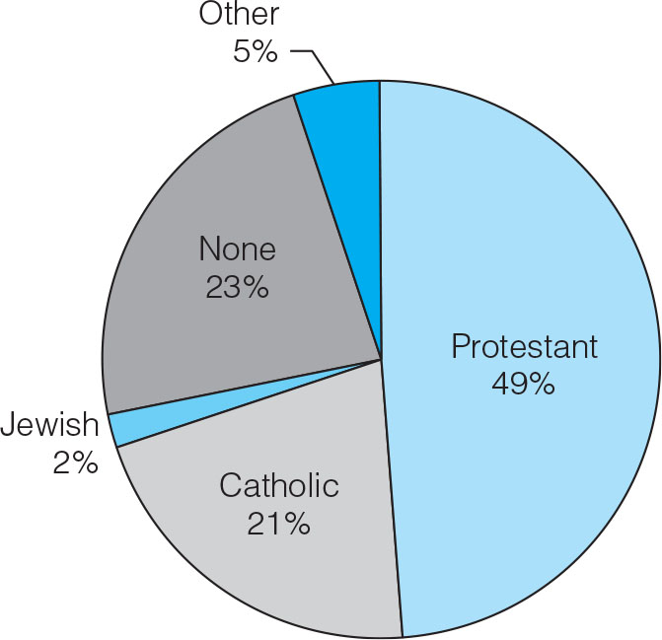
Sample Pie Chart: Religious Identifications, 2008
Pie charts are useful for discrete variables with only a few categories. The pie is divided into segments which are proportional in size to the percentage of cases in each category.

Slide 38
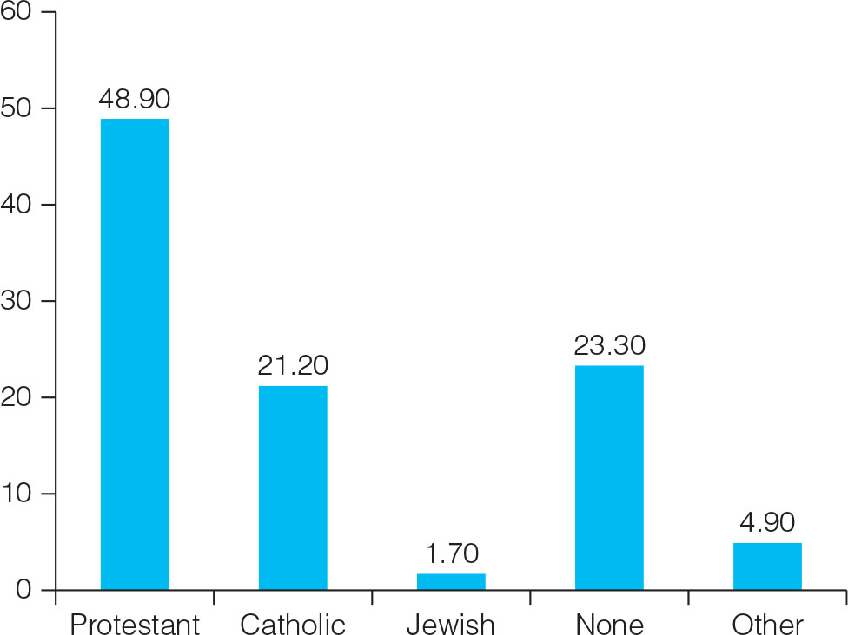
Sample Bar Chart: Religious Identifications, 2008
Bar charts are useful for discrete variables. The categories are represented by bars. The height of these bars corresponds to the number or percentage of cases in each category.
Self-Described Religious Identifications of Adult Americans, 2018

Slide 39
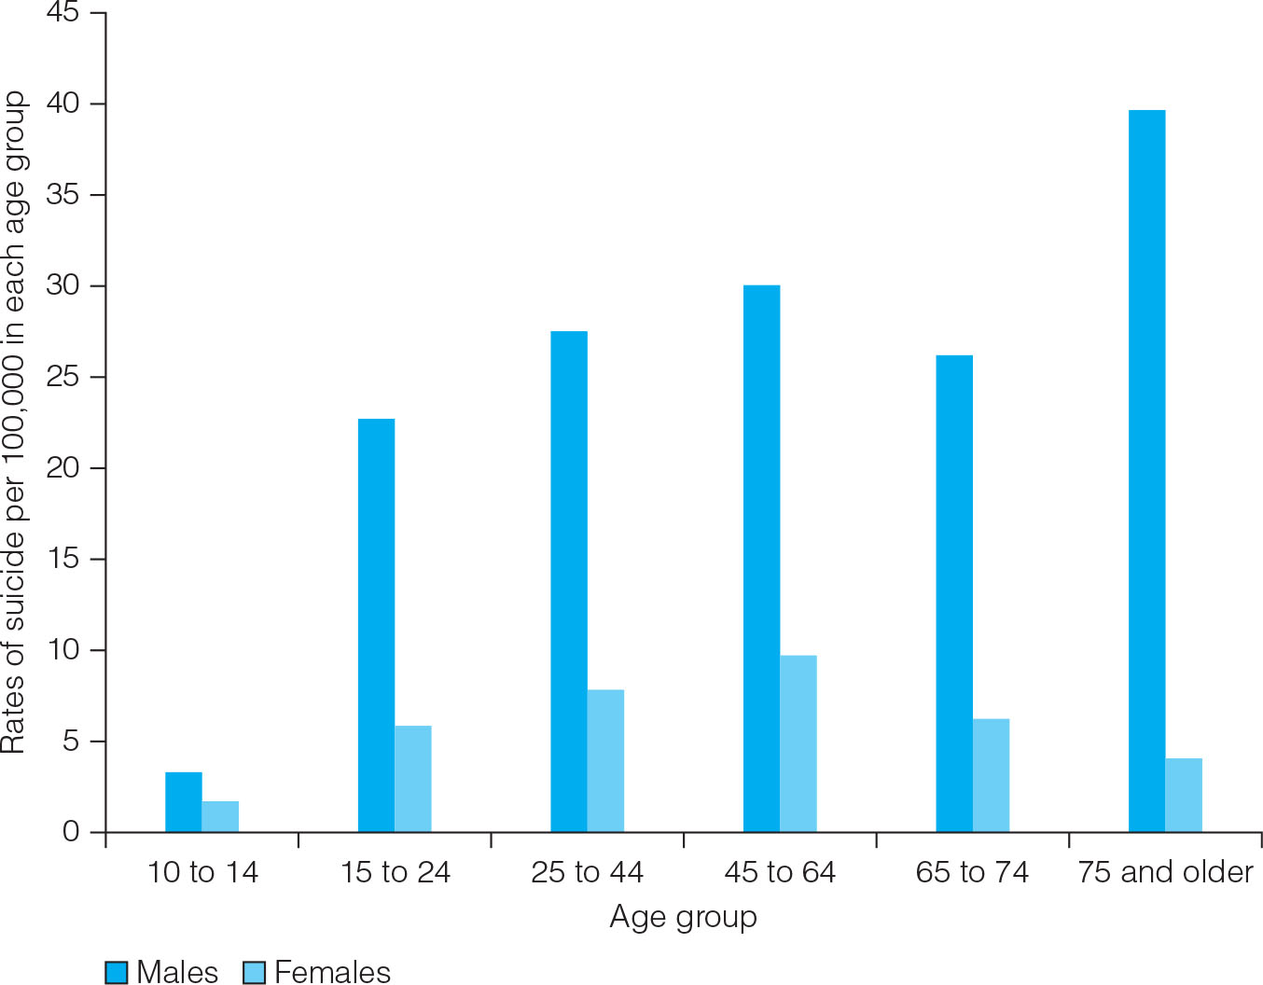
Sample Bar Chart: Comparing Two Variables
Suicide Rates for Males and Females by Age Group, 2017

Slide 40
Histograms
Most appropriate for continuous interval-ratio level variables, but can be used for discrete interval-ratio level variables
Look like bar charts
Use real limits instead of stated limits
Categories (or scores) of the variable border each other (the sides of the bars touch)

Slide 41
Constructing a Histogram from a Frequency Distribution
Array the real limits of the class intervals or scores along the horizontal axis (abscissa)
Array frequencies along the vertical axis (ordinate)
For each category, construct a bar with height corresponding to number of cases and width corresponding to real limits of class intervals
Label each axis of graph
Title the graph

Slide 42
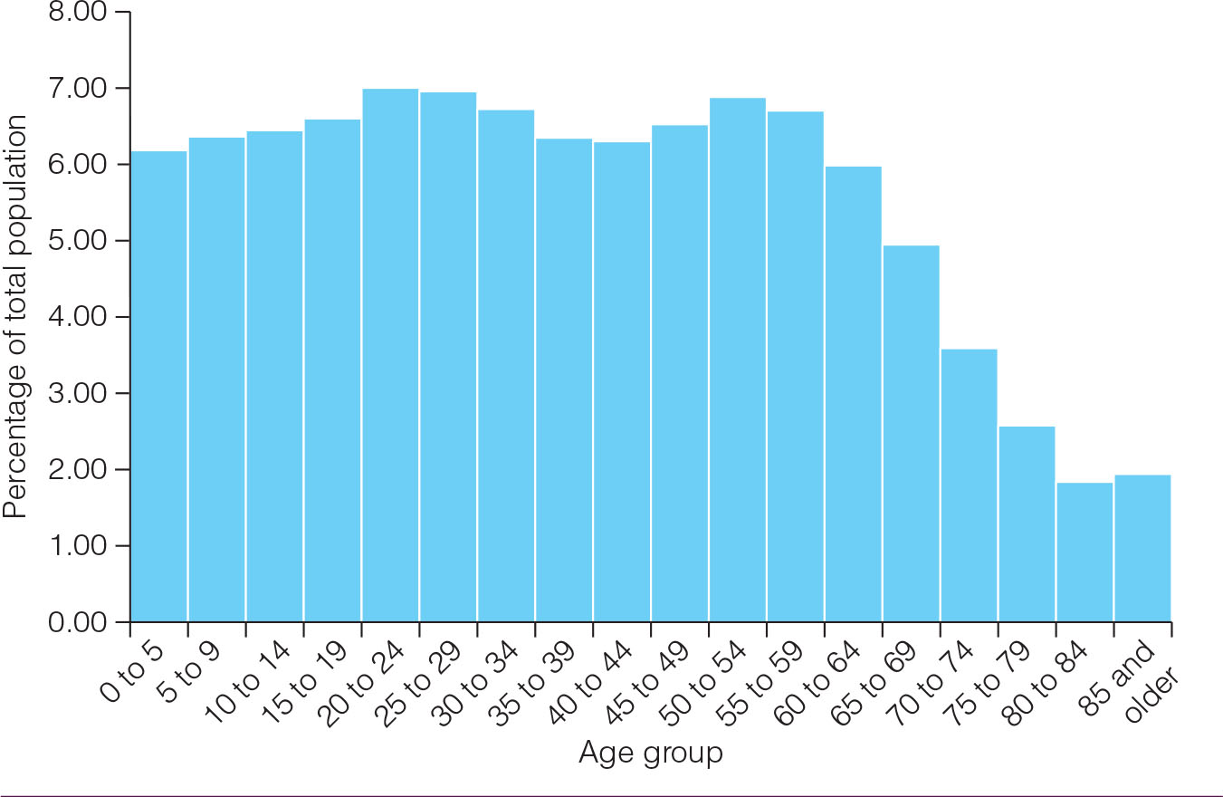
Sample Histogram: Age, 2010
Age Distribution of the United States, 2017
Source: U.S. Bureau of the Census. 2018. American Community Survey. 2013–2017, Five Year Estimates.
https://factfinder.census.gov/faces/tableservices/jsf/pages/productview.xhtml?pid=ACS_17_5YR_S0101& prodType=table

Slide 43
Line Charts
Sometimes called frequency polygons
Constructed similarly to a histogram, except graph a dot at each category’s midpoint and then connect the dots
Especially appropriate for continuous interval-ratio level variables, but can be used for discrete interval-ratio level variables

Slide 44
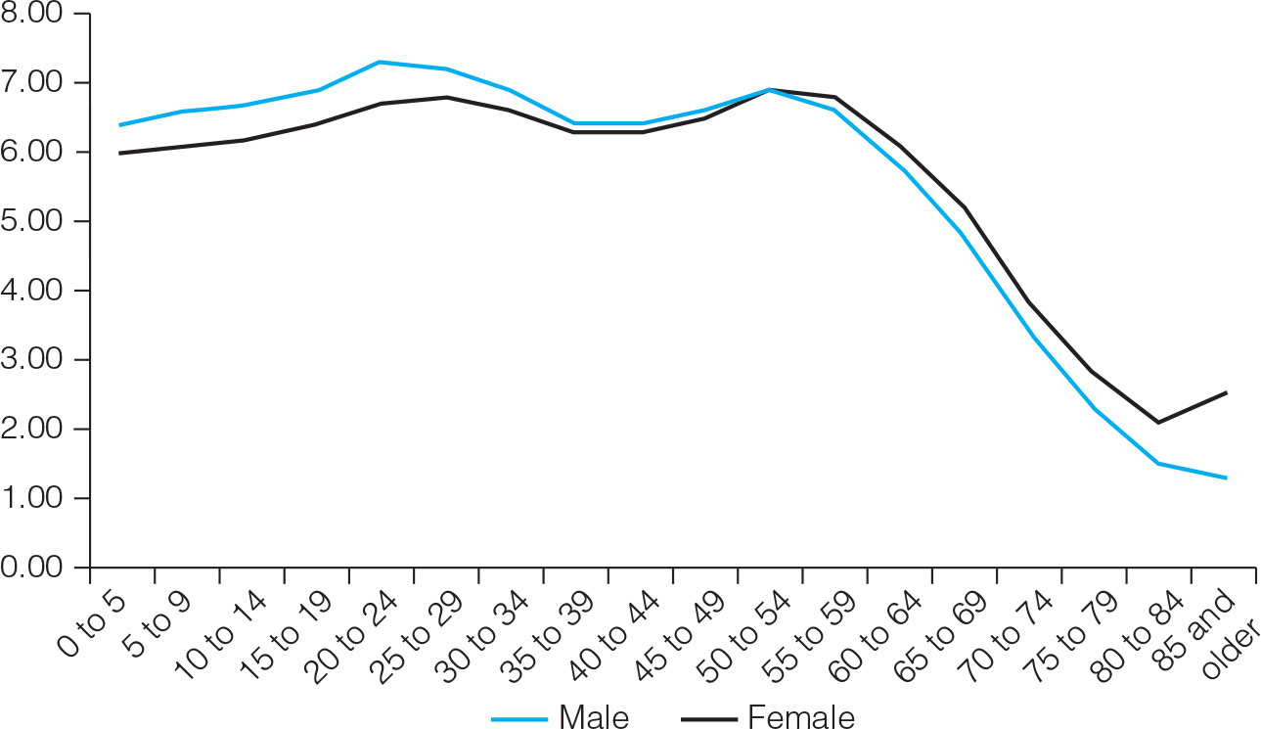
Sample Line Chart: Age, 2010
Age Distribution of the Population of the United States by Gender, 2017
Source: U.S. Bureau of the Census. 2018. American Community Survey. 2013–2017, Five Year Estimates.
https://factfinder.census.gov/faces/tableservices/jsf/pages/productview.xhtml?pid=ACS_17_5YR_S0101& prodType=table

Slide 45
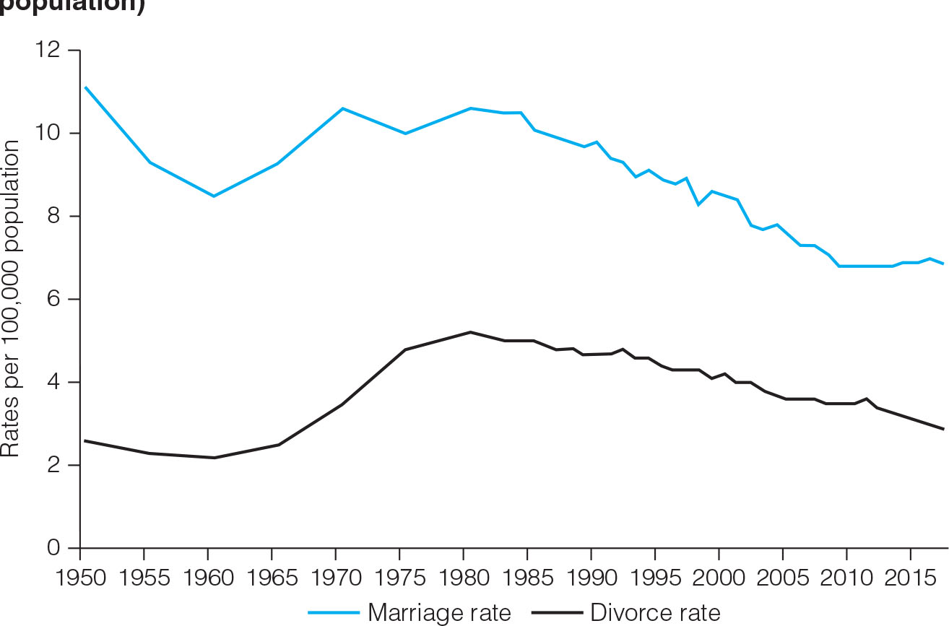
Line Charts: Marriage And Divorce Rates Over Time
How would you describe the patterns?
U.S. Rates of Marriage and Divorce, 1950–2017 (rates per 100,000 population)

